Slide 1
Release process:
Build new release exe file
Upload new file to server public
Get download link
Create new release CL

Slide 2
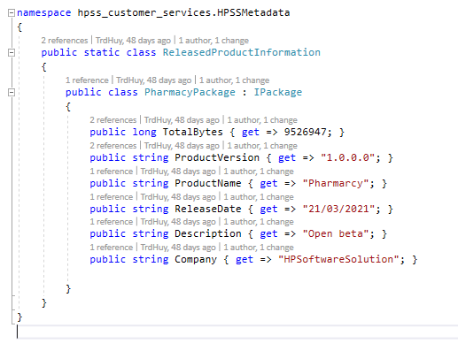
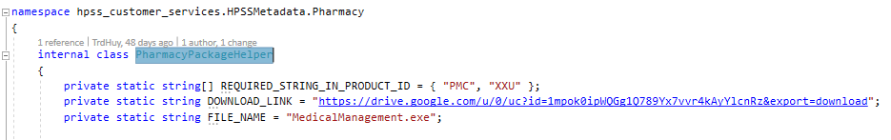
Create new release CL:
Access hpss-customer-service Azure project in VisualStudio
In ReleasedProductInformation.cs , change package info
In PharmacyPackageHelper.cs, update the download link and exe file name if change
Submit CL to gerrit for review
Publish new Azure function in VisualStudio

